Slide 1
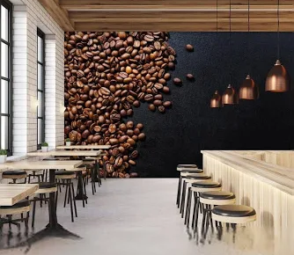
BRIGHT COFFEE SHOP | SHOPPING TRENDS Andile Ngcongwane | DATA ANALYTICS

Slide 2
Total number of sales over 6 months: 149116 The shop sales have been consistently making higher sales over the period of 6 months, evidently sales grow as seasons approach winter

Slide 3
Revenue per day of the week for each shop Data in this chart specifies the top performing shop per day of the week Hell’s Kitchen generate the most revenue on Tuesdays and Fridays than all the shops Lower Manhattan takes the number 2 spot for revenue it generates on Mondays, but is closely followed by Astoria on the same day However, on Wednesdays and Thursdays Astoria keeps their revenue higher than all the shops Fridays is Hell’s Kitchen day due to their high revenue they suddenly gain beating all 3 shops by a mile

Slide 4
Number of Sales (Weekday/Weekend) The establishment makes better sales during the week than it does on the weekends, perhaps this is caused by the customers seeing the establishment as an ideal place to fill the rush before business day begins

Slide 5
Revenue per time of day (Morning, Afternoon and Evening) Sales reflect that every morning at all stores customers buy more as compared to the afternoons and evenings which simply means the products are good for mornings consumption.

Slide 6
Revenue per season The store makes the most sales in winter, the season before which is autumn the sales reflect a rally in trend indicating that the products are ideal for a cold weather. If we look back at the previous data of time of day, the mornings make better sales than afternoons and evenings which still indicates the same point of the products being ideal for the cold weather.

Slide 7
Transaction QTY per product category The sales from the perspective of product categories clarifies why we see sales performing better during the winter mornings, and that is because hot products like coffee and tea, and the bakery are most loved in this establishment, better than just buying coffee beans and some flavours.

Slide 8
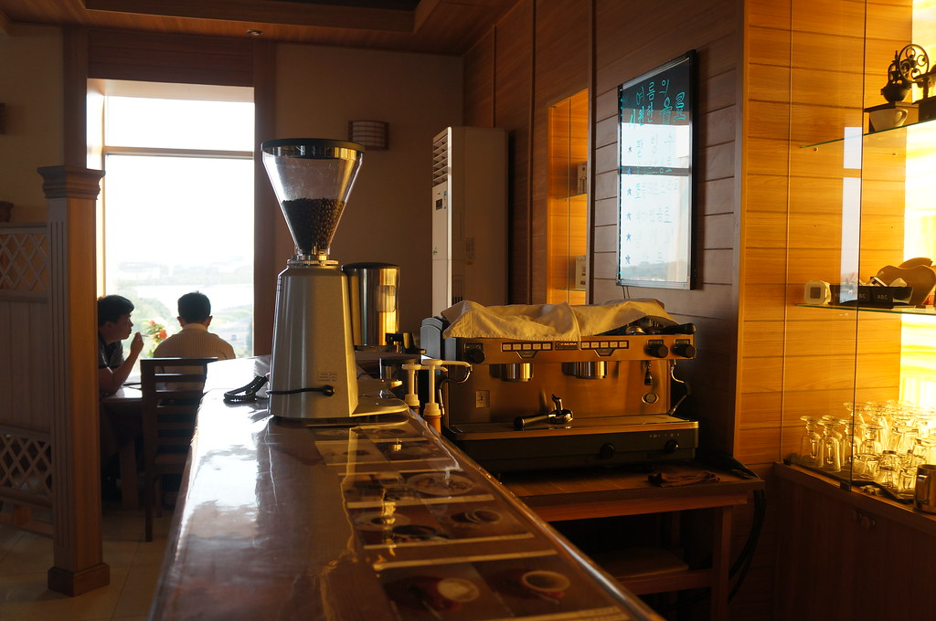
DISCOVERY & RECOMMENDATIONS
Increase Sales Through Targeted Product Combinations
Insight: Certain days generate lower revenue based on analyzed sales data.
Action: Introduce flavor add-ons paired with coffees and teas and promote these combinations on low-performing days.
Benefit: Increased flavor sales and higher average spend per customer.
This Photo by Unknown Author is licensed under CC BY-SA

Slide 9
DISCOVERY & RECOMMENDATIONS
Boost Weekend Sales with Campaign Days
Insight: Weekend sales are consistently lower.
Action: Run weekend campaign days offering promotion packs (coffee beans and packaged chocolates), with specific appeal to families and children.
Benefit: Improved weekend foot traffic and product movement.
This Photo by Unknown Author is licensed under CC BY-SA

Slide 10
DISCOVERY & RECOMMENDATIONS
Expand Cold Beverage Range for Summer and Evenings
Insight: Demand for refreshing drinks increases during summer and in the evenings.
Action: Introduce Freezo’s, slush drinks, iced coffees, and iced teas.
Benefit: Higher summer and evening sales.
This Photo by Unknown Author is licensed under CC BY-SA

Slide 11
DISCOVERY & RECOMMENDATIONS
Seasonal Themed Campaigns
Insight: Seasonal experiences can drive customer engagement.
Action: Introduce summer picnic-themed campaigns alongside promotional offers.
Benefit: Increased campaign visibility and customer retention.
This Photo by Unknown Author is licensed under CC BY-SA

